Slide 1
OOM MINI PROJECT

Slide 2

GAME OF LIFE
Members-
UTKARSH SRIVASTAVA - IIT2014507
PRANJIT BHARALI - IIT2014151
SHIVAM BERI - IIT2014159
Under Guidance of –
Prof.O.P Vyas
Dr.Ranjana Vyas

Slide 3
INTRODUCTION
GAME DESCRIPTION :
GAME OF LIFE also known as CONWAY'S GAME OF LIFE is a zero-player game, meaning that its evolution is determined by its initial state, requiring no further input. One interacts with the Game of Life by creating an initial configuration and observing how it evolves or, for advanced players, by creating patterns with particular properties.

Slide 4
INTRODUCTION (CONT.)
Rules
The universe of the Game of Life is an infinite two-dimensional orthogonal grid of square cells, each of which is in one of two possible states, alive or dead. Every cell interacts with its eight neighbours, which are the cells that are horizontally, vertically, or diagonally adjacent. At each step in time, the following transitions occur:
Any live cell with fewer than two live neighbours dies, as if caused by under-population.
Any live cell with two or three live neighbours lives on to the next generation.
Any live cell with more than three live neighbours dies, as if by over-population.
Any dead cell with exactly three live neighbours becomes a live cell, as if by reproduction.

Slide 5
OBJECTIVE
Objective of this project is to design an GUI application that shows the principle and working of Conway’s Game Of Life.

Slide 6
TECHNOLOGIES USED
Platform - JAVA
Tool used - Netbeans IDE-8.0 with JDK 7u80
Why Java ?
Java is general purpose object-oriented programming language with the number of features that make the language well suited for use on all the platforms.

Slide 7
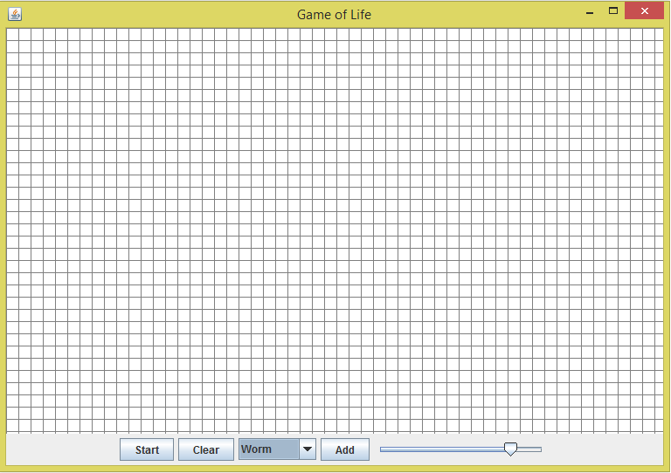
SNAPSHOTS
Blank Grid

Slide 8
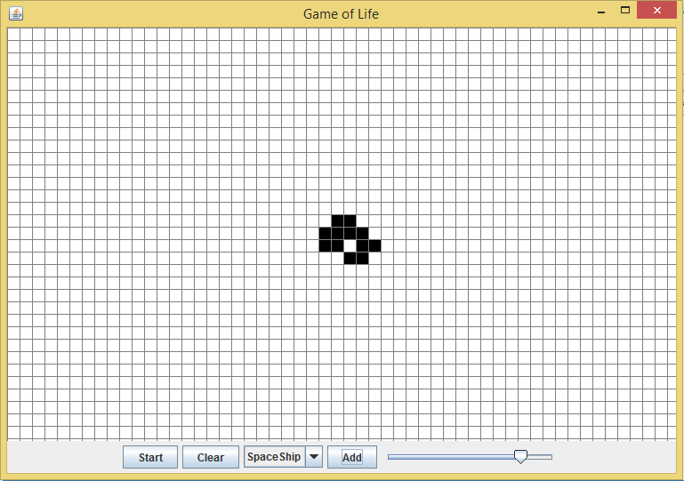
SNAPSHOTS
Added a predefined Design

Slide 9
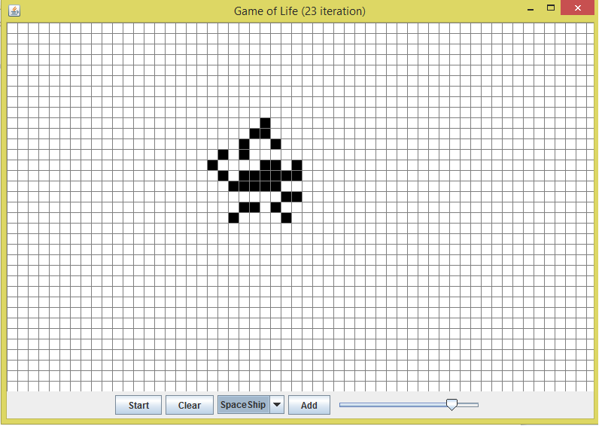
SNAPSHOTS
Design after 23 iterations

Slide 10
FUNCTIONAL COMPONENTS
A pause/play button.
A clear button to erase the window.
A drop down menu to select any pre-designed pattern.
An add button to add selected pattern from drop down menu.
A slider to control the speed of the game.

Slide 11
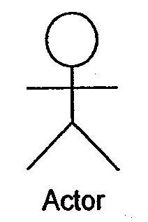
USE CASE DIAGRAM :
Use Case

Slide 12
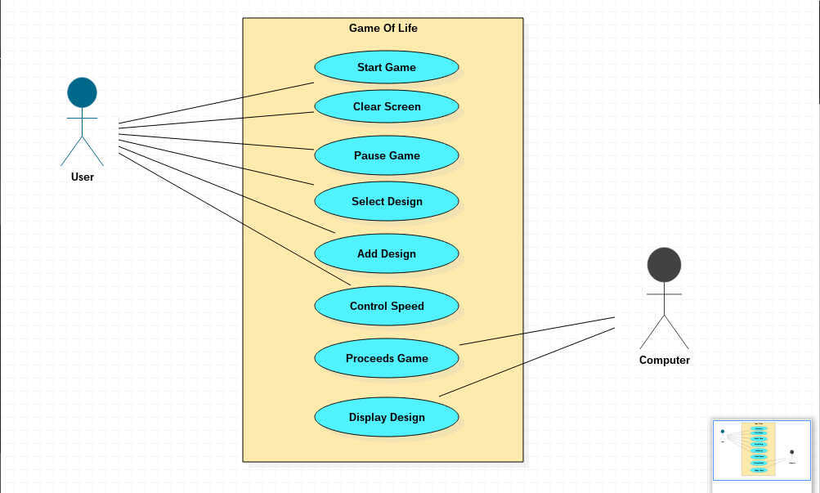
USE CASE DIAGRAM :

Slide 13
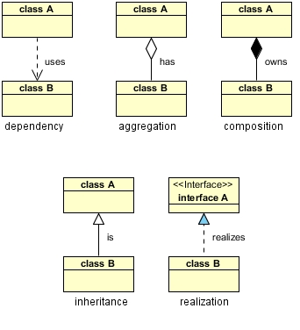
CLASS DIAGRAM
Relationships in Class Diagram

Slide 14
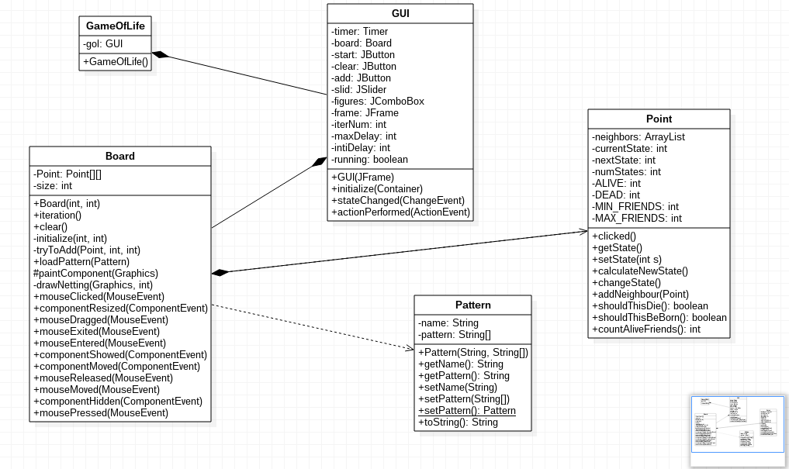
CLASS DIAGRAM

Slide 15
Class-responsibility-Collaboration (CRC) cards
Class name
Responsibility Collaboration

Slide 16
Class-responsibility-Collaboration (CRC) cards
GameOfLife
Responsibility Collaboration
Main Class.
Initializes Game
GUI

Slide 17
Class-responsibility-Collaboration (CRC) cards
GUI
Responsibility Collaboration
Defines how the Grid and
buttons appears.
Board

Slide 18
Class-responsibility-Collaboration (CRC) cards
Board
Responsibility Collaboration
Determines what happens
on every event on the
board.
Point
Pattern

Slide 19
Class-responsibility-Collaboration (CRC) cards
Point
Responsibility Collaboration
Determines the operations related to every point (pixel) on the grid.

Slide 20
Class-responsibility-Collaboration (CRC) cards
Pattern
Responsibility Collaboration
Has the predefined
patterns stored.

Slide 21
Thank you

